Slide 1

Global Heart of Peace Sponsored
Season of Peace and Nonviolence
Week 1

Slide 2
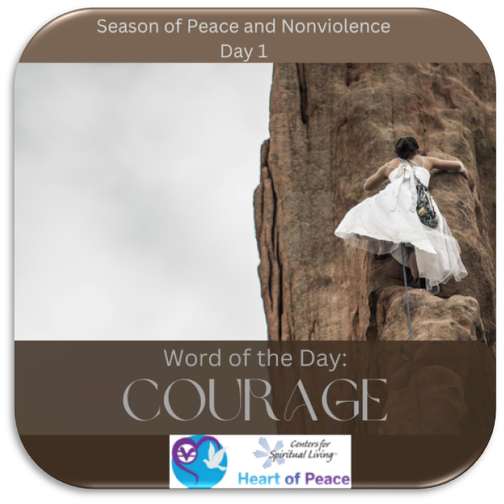
Day 1: Courage
What does courage mean to you?
Where do you find it hardest to act with courage?
Where can you most benefit from acting with courage?
Is there somewhere in your life that would benefit from courageous conversations?
What steps will you commit to taking to act with courage in your life?

Slide 3
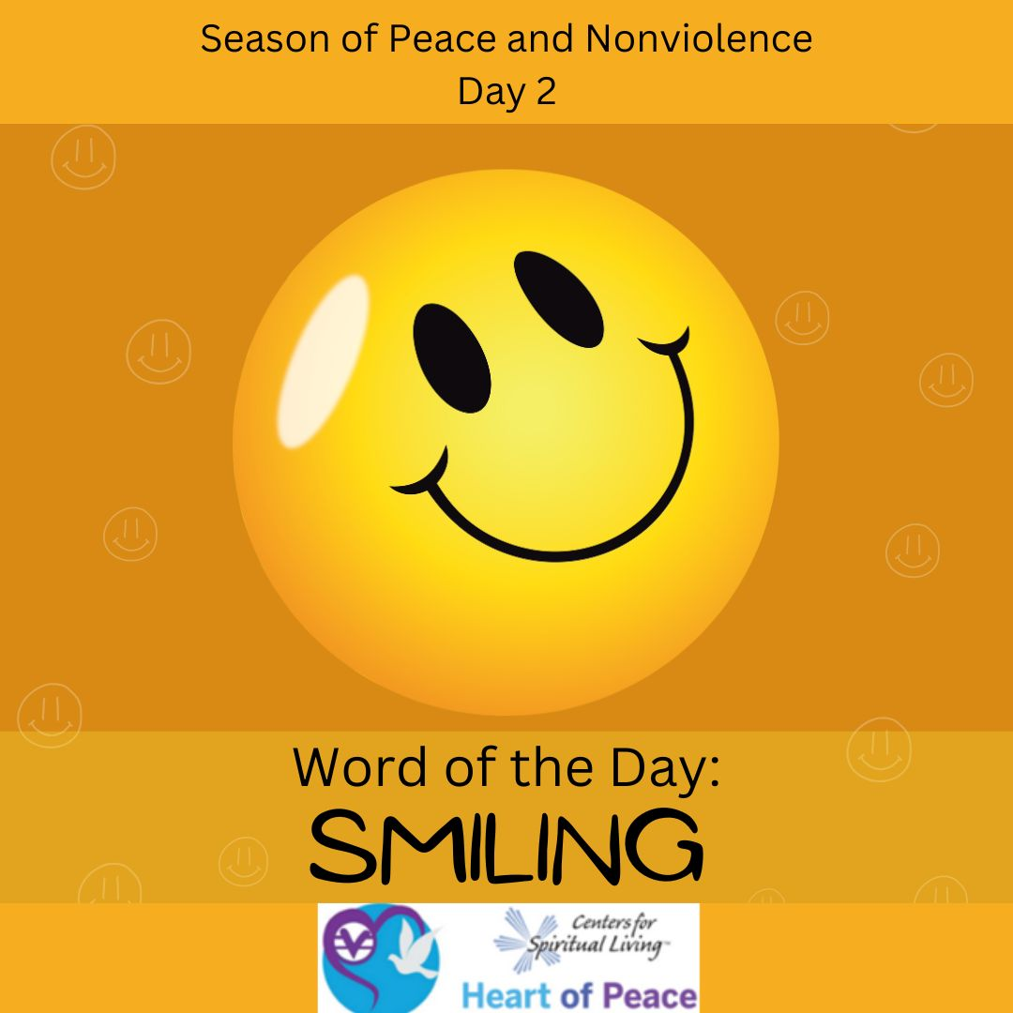
Day 2: Smiling
Think about a time someone smiled at you when you were having a hard day, how did that make you feel?
Is smiling easy for you? If not, why not?
What can you do to start smiling when things get hard?
What steps are you willing to take to allow smiling to have a healing effect in your life?

Slide 4
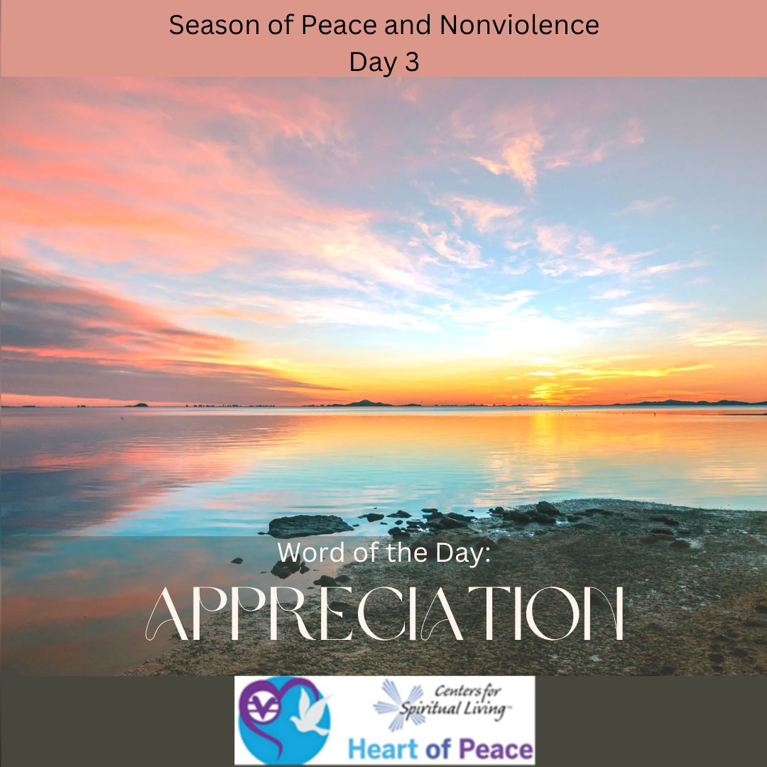
Day 3: Appreciation
What does it mean to you to feel appreciated?
How do you show appreciation to someone you care for?
How do you show appreciation for someone you don’t know/like?
What areas of your life can you show more appreciation?
What steps can you take to appreciate all that you have when things are hard?

Slide 5
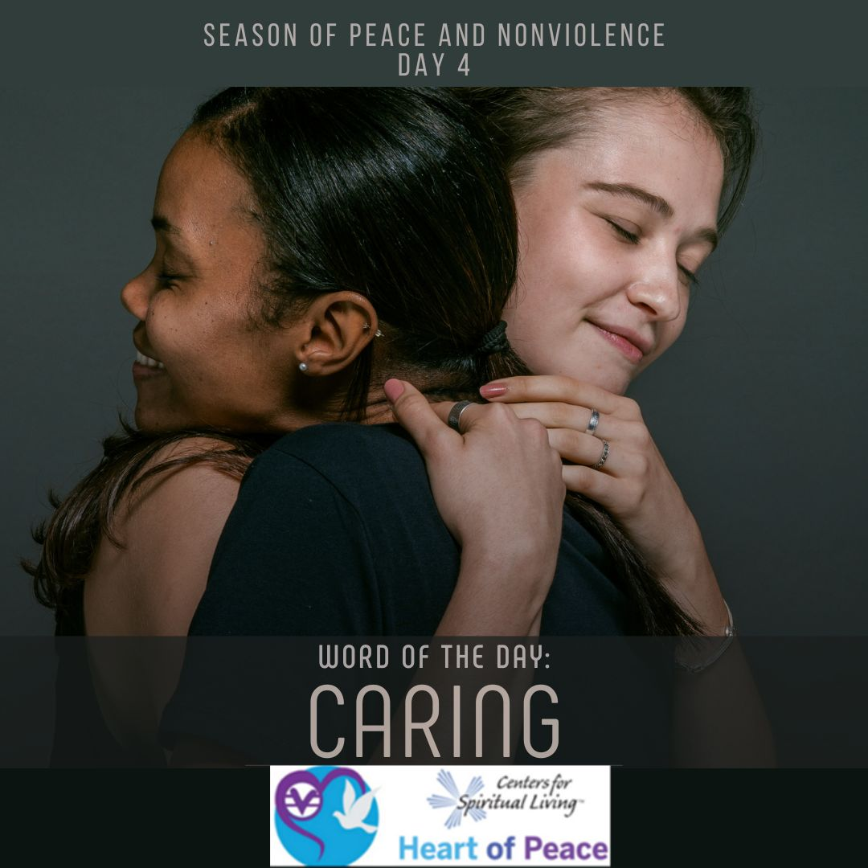
Day 4: Caring
What does caring mean to you?
Where in your life could you benefit from intentional caring?
What group of people is it hard for you to show caring towards? Why?
What steps are you willing to take to commit to caring for someone who is difficult to care for? (this could include yourself)

Slide 6

Day 5: Believing
Where do you struggle to believe?
What can expanding your beliefs do to your life?
What is something you believe in that has been a challenge but means the most to you?
Where is a place that your beliefs conflict with someone you care about? What steps are you willing to take to see things from their perspective?
How do you share your beliefs with people who believe differently than you?

Slide 7
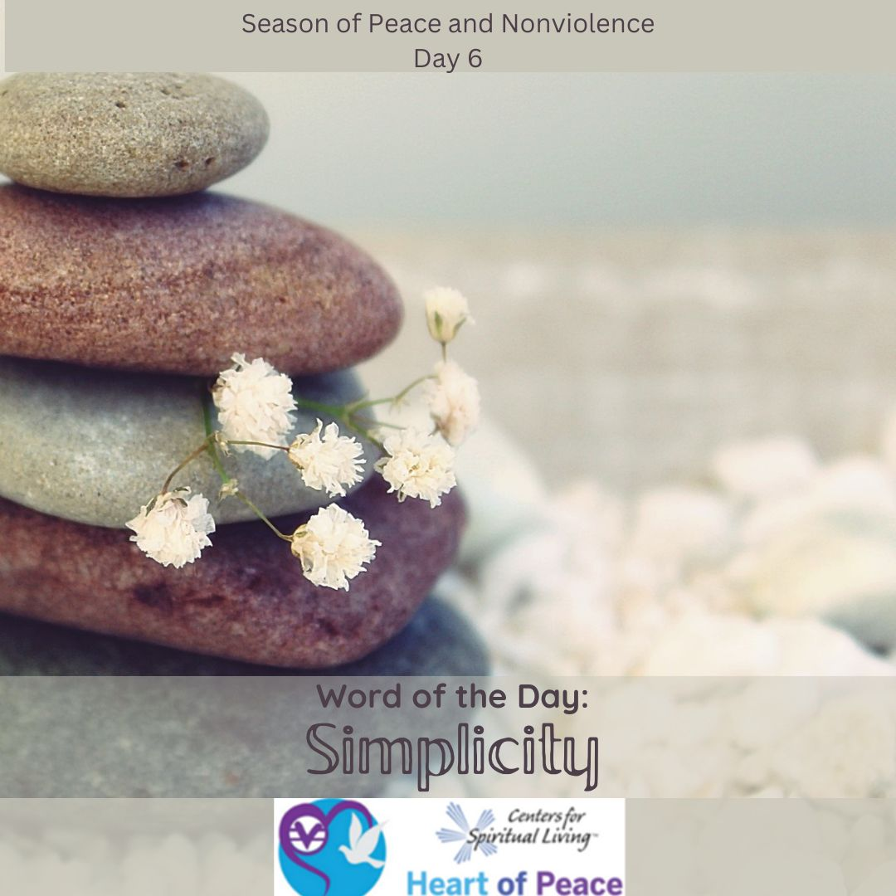
Day 6: Simplicity
What does simplicity mean to you?
Are there places in your life that could benefit from simplicity?
What benefits can you see in adding more simplicity to your life?
What steps are you willing to take to add simplicity to your life?

Slide 8
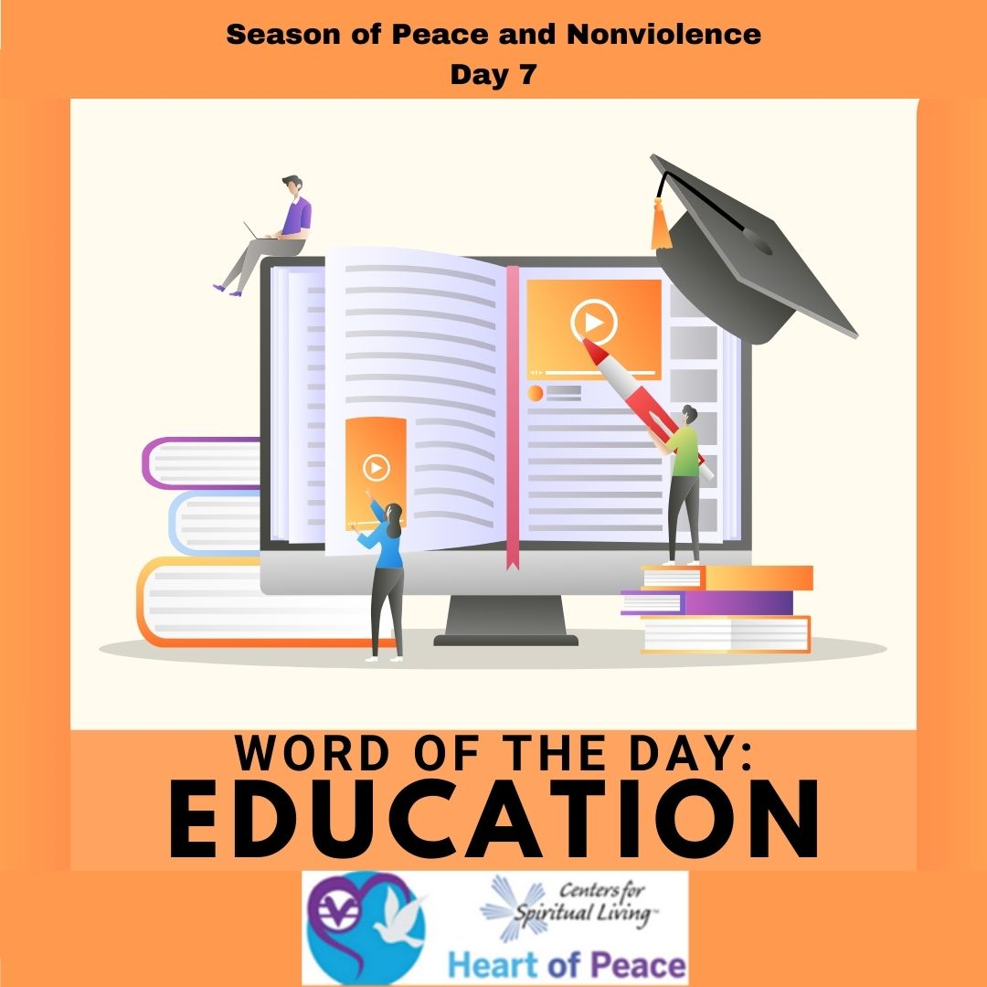
Day 7: Education
Many people think education stops when we leave school, how can we keep education alive and enjoyable?
What is something that you would like to learn that would expand your understanding of others?
How can continuing your education improve your relationships?
What steps are you willing to take to continue your education?

Slide 9
Summary Questions
How do this week's words apply to peace and nonviolence?
What challenges do this week’s words bring up for you?
What words do you feel you need to spend more time with?
What would help you most in incorporating these words in your life?

Slide 10
Week 1 Words- Added Resources
Day 1 – COURAGE (Jan. 30) -Courage is the ability to do what is in your heart. Today, really listen to what is in your heart. It takes courage to be nonviolent.
Day 2 – SMILING (Jan. 31)-Smiling is a way to establish a heart-to-heart connection and to create a peaceful outlook. Smile from the heart. Today, smile and make eye contact with at least 5 people. Notice how people respond to you.
Day 3 – APPRECIATION (Feb. 1)-Author Louise Hay says, “Praise yourself as much as you can. The love in our lives begins with us…loving yourself will help heal our planet.” Today, focus on appreciating the good qualities in yourself and others.
Day 4 – CARING (Feb. 2)-To truly care for others, you must first truly care for yourself. Today, think of ways you can better care for yourself. Practice at least one of those ideas today.
Day 5 – BELIEVING (Feb. 3)-Peace is a possibility. Believing in that possibility can make it happen. Keep peace in mind.
Day 6 -- SIMPLICITY (Feb. 4)- Drama makes our lives more complicated. Think of ways to free your self from drama. Practice one today.
Day 7 – EDUCATION (Feb. 5)-War is born from ignorance. Today, try and learn something new.
Document Source: Microsoft Word - 64-Daily_Practices-TEENS.doc

