Slide 1

Global Heart of Peace Sponsored
Season of Peace and Nonviolence
Week 10

Slide 2
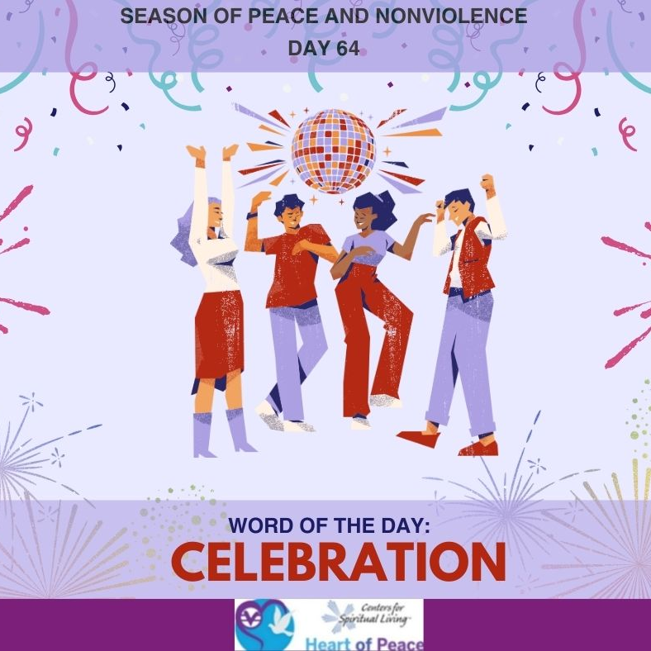
Day 64 & 65: Celebration
How does it feel to celebrate peace?
Why is it important to celebrate peace?
You have been studying peace and non-violence for 9 weeks, how has it affected your life?
What will you be taking with you from these meetings?

Slide 3
Peace Pantoum
As a conclusion to these meetings we will go through a process to create a poem on what peace means to you either on a personal level or a global level. The facilitator will lead you through a process then give you an opportunity to share what you create with the group. This will lock in for you what peace means to you and how you will bring peace into your world moving forward.

Slide 4
Pantoum Format- Please Copy on a Piece of Paper
1
2
3
4
2
5N
4
6N
5
7N
6
8N
7
3
8
1

Slide 5
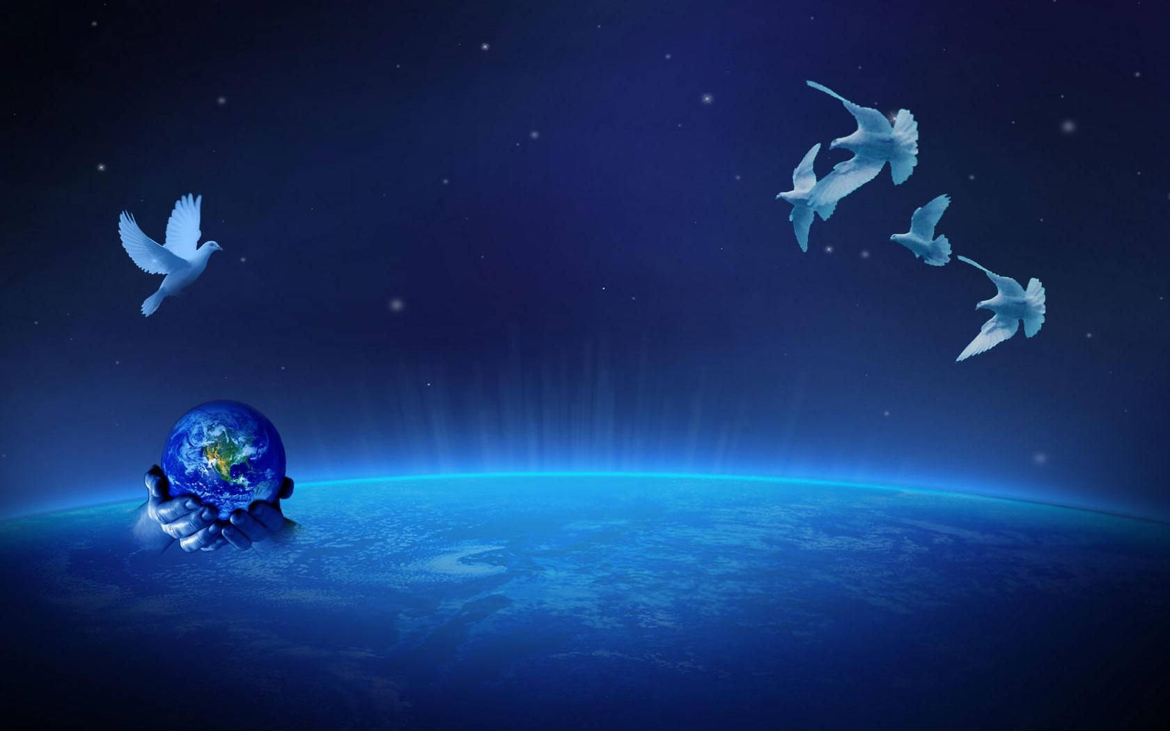
Guided Meditation

Slide 6
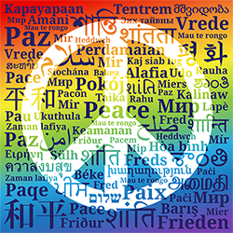
Pantoum Review
What did it feel like to write this process?
What did you discover about your feelings around peace that is new to you?
What from this process will you bring forward into your life to increase a focus on peace?
What steps are you willing to commit to taking in creating the peace you wrote about?

Slide 7
Week 10 Words- Added Resources
Days 64 and 65 – CELEBRATION (April 3 and 4)- Today is a day to celebrate all the work that you have done. Be proud of yourself for being willing to be the change you wish to see in the world. "Never doubt that a small group of thoughtful, committed citizens can change the world. Indeed, it's the only thing that ever has."
Document Source: Microsoft Word - 64-Daily_Practices-TEENS.doc

