Slide 1

Global Heart of Peace Sponsored
Season of Peace and Nonviolence
Week 4

Slide 2

Day 22: Mission
How do you know what your mission is?
Why is it important to have a mission?
How does your mission benefit mankind?
What are you doing to live in alignment with your mission?

Slide 3
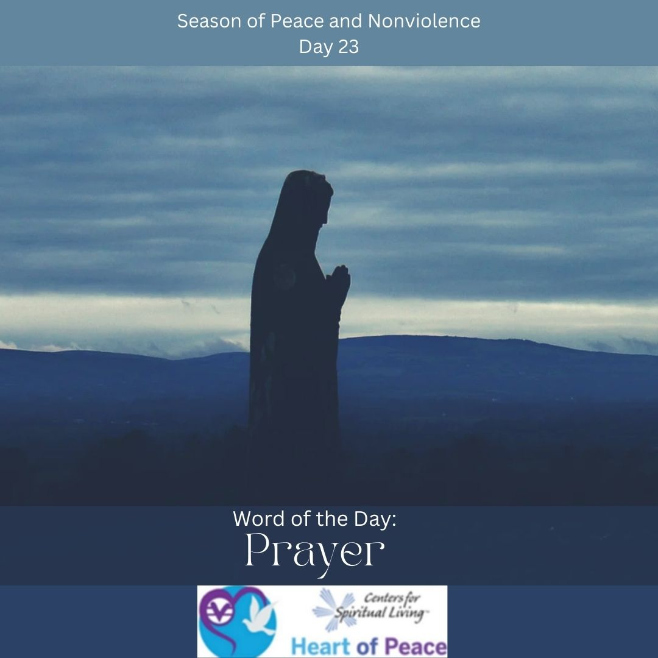
Day 23: Prayer
Why is prayer important?
How important are the words you choose when you pray?
How often should you pray?
Is there a wrong way to pray?
What do you think would happen if you increased how much you pray?

Slide 4
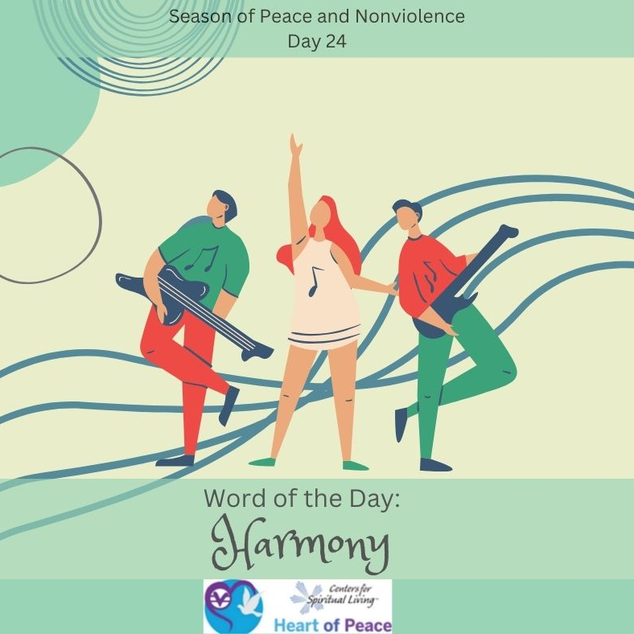
Day 24: Harmony
What is harmony?
How can we increase harmony in our relationships?
Do you have to always be in agreement to have harmony?
What steps are needed to ensure harmony?

Slide 5
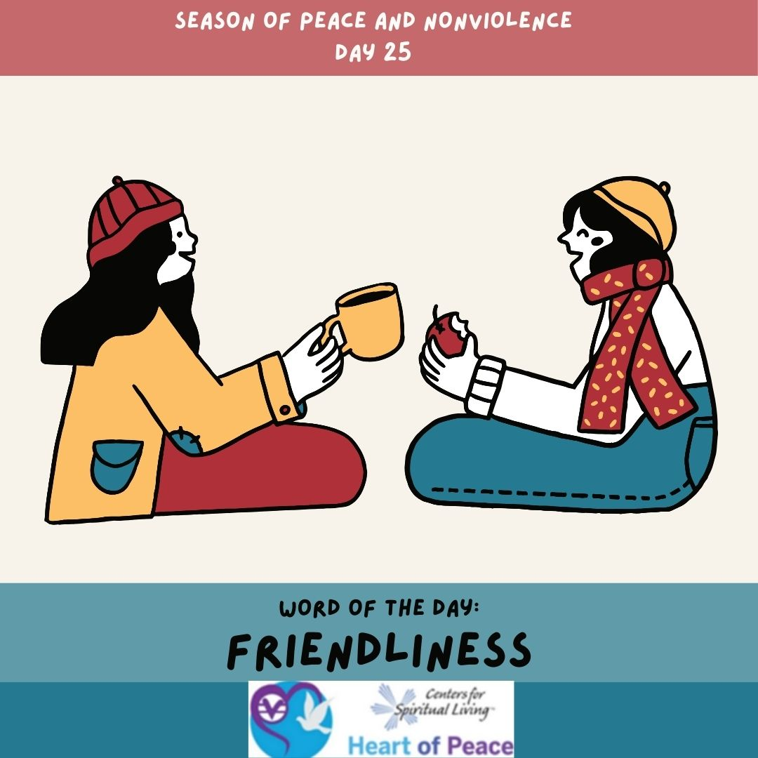
Day 25: Friendliness
What makes a good friend?
How can we practice friendliness with those we don’t care for?
Why is it important to be friendly especially when we aren’t feeling friendly?
How can increased friendliness change the world?

Slide 6
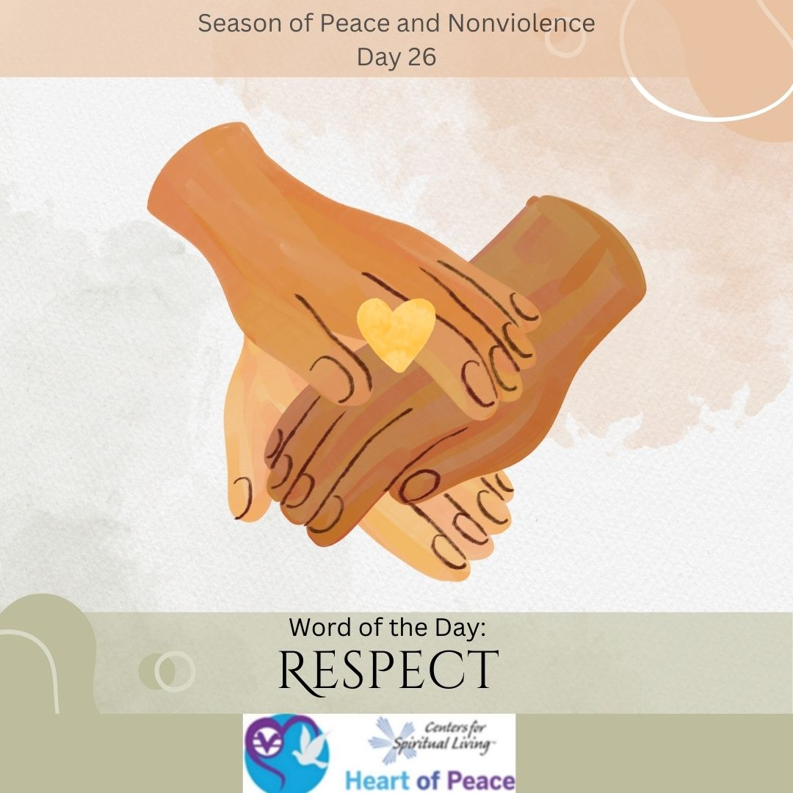
Day 26: Respect
What does respect feel like?
How do we practice respect for people who we don’t agree with?
Does respect need to be earned?
Do you have to approve of everything someone does to respect them?
How easy is it to respect yourself? Is it possible for other’s to respect you if you can’t respect yourself?

Slide 7

Day 27: Generosity
What does generosity mean to you?
In what ways can you be generous without being rich?
Can you be too generous? What effects can happen to your life if you are too generous?
What happens if you are more generous than someone else in a relationship?
What blocks do you have around generosity?

Slide 8
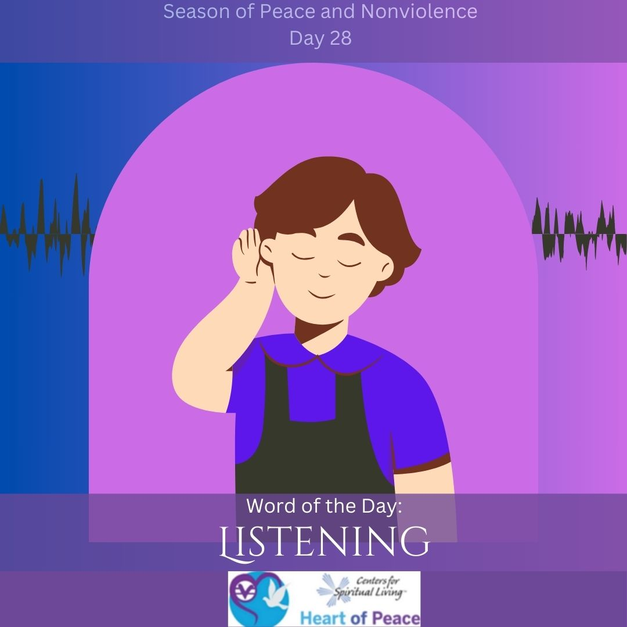
Day 28: Listening
Why is listening important?
What blocks do you experience in listening?
What do you do when listening to something makes you feel uncomfortable?
How can you tell when someone is truly listening? How does it make you feel?
What effects can listening have on relationships?

Slide 9
Summary Questions
How do this week's words apply to peace and nonviolence?
What challenges do this week’s words bring up for you?
What words do you feel you need to spend more time with?
What would help you most in incorporating these words in your life?

Slide 10
Week 4 Words- Added Resources
Day 22 – MISSION (Feb. 20)-“My life is my message," Gandhi said. Gandhi's mission was to be nonviolent. What is your life's mission? Think about what you want to bring to the world. What are your intentions? Write down some of your ideas if you choose.
Day 23 – PRAYER (Feb. 21)- Gandhi said: "Prayer from the heart can achieve what nothing else in the world can." Take a moment. Visualize peace in your heart, in your friends, in your family, on the planet. Let peace begin with you.
Day 24 – HARMONY (Feb. 22)- Bring Harmony today. See the good in yourself and others. Say only good things about others today.
Day 25 – FRIENDLINESS (Feb. 23)- Do you know that strangers are simply friends you haven't met yet? Expand your circle of friends today. Meet someone new. Say "Hi" to five people you don't know or just be friendly to someone that you have never made the effort with before.
Day 26 – RESPECT (Feb. 24)- We all deserve respect. Think of how it feels to be disrespected. We are all very different people, but really, we are all the same. We are all human. The world would be really boring if we were all the same. Respect the diversity of others.
Day 27 – GENEROSITY (Feb. 25)- Start a chain reaction today. Give generously from your heart. Share a kind word. Do someone a kindness. Watch it flow from person to person. Give mindfully and it flows back to enrich you.
Day 28 – LISTENING (Feb. 26)- Do you know how to really listen to another person? Do you know how to give another person your full attention, as if nothing else matters than what the other person is saying? Do you know how to look directly at the person who is speaking without thinking about other things? Do you know how to keep your body still while you're listening? Try this today. Be present now. Listen with your heart.
Document Source: Microsoft Word - 64-Daily_Practices-TEENS.doc

