Slide 1

Global Heart of Peace Sponsored
Season of Peace and Nonviolence
Week 6

Slide 2
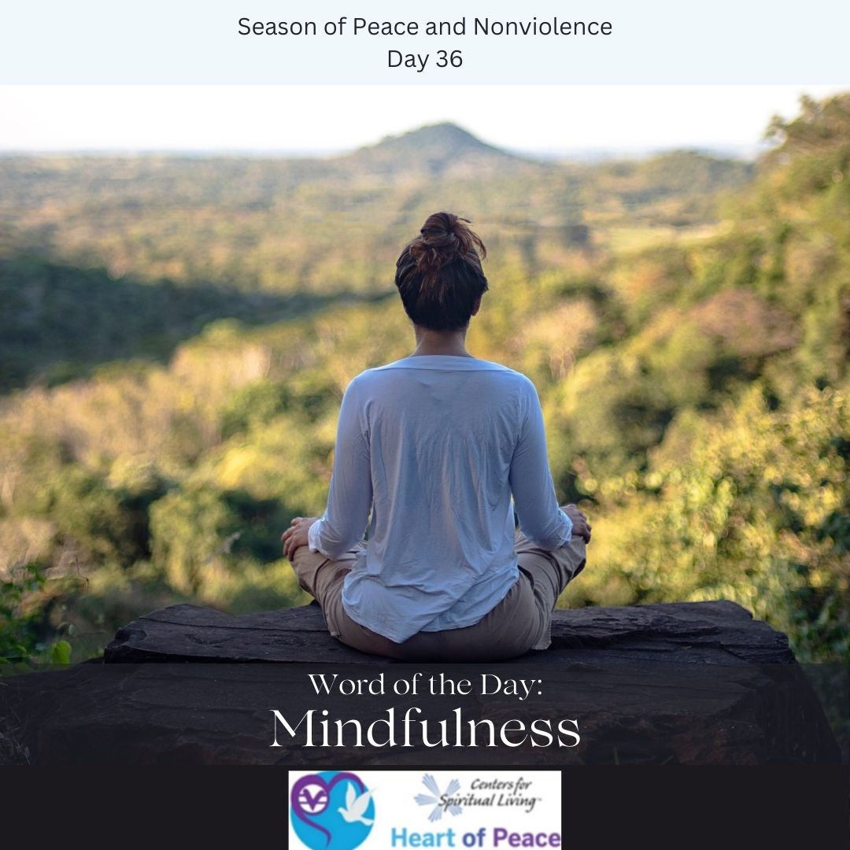
Day 36: Mindfulness
What is mindfulness?
How does mindfulness improve your life?
How do you make mindfulness a daily practice?

Slide 3
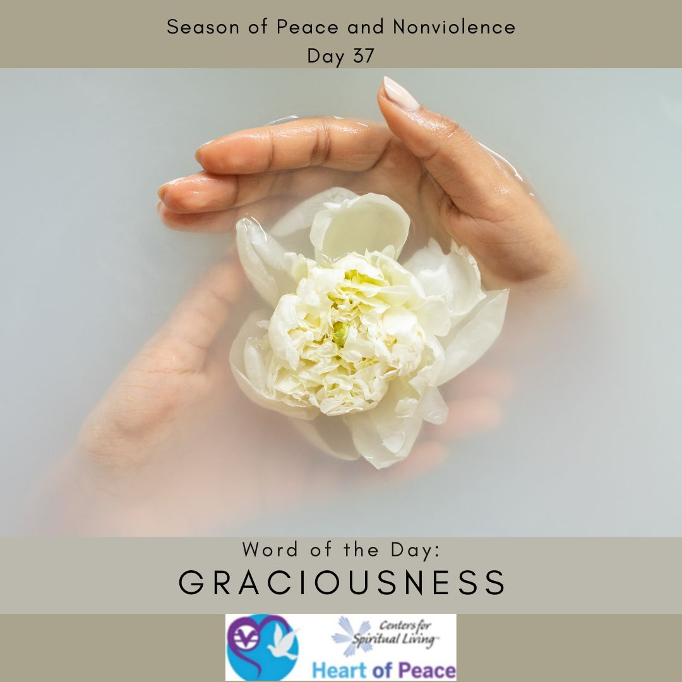
Day 37: Graciousness
What does it mean to be gracious?
Why is graciousness important?
How do show graciousness when things become difficult?
When is it most important to show graciousness?

Slide 4
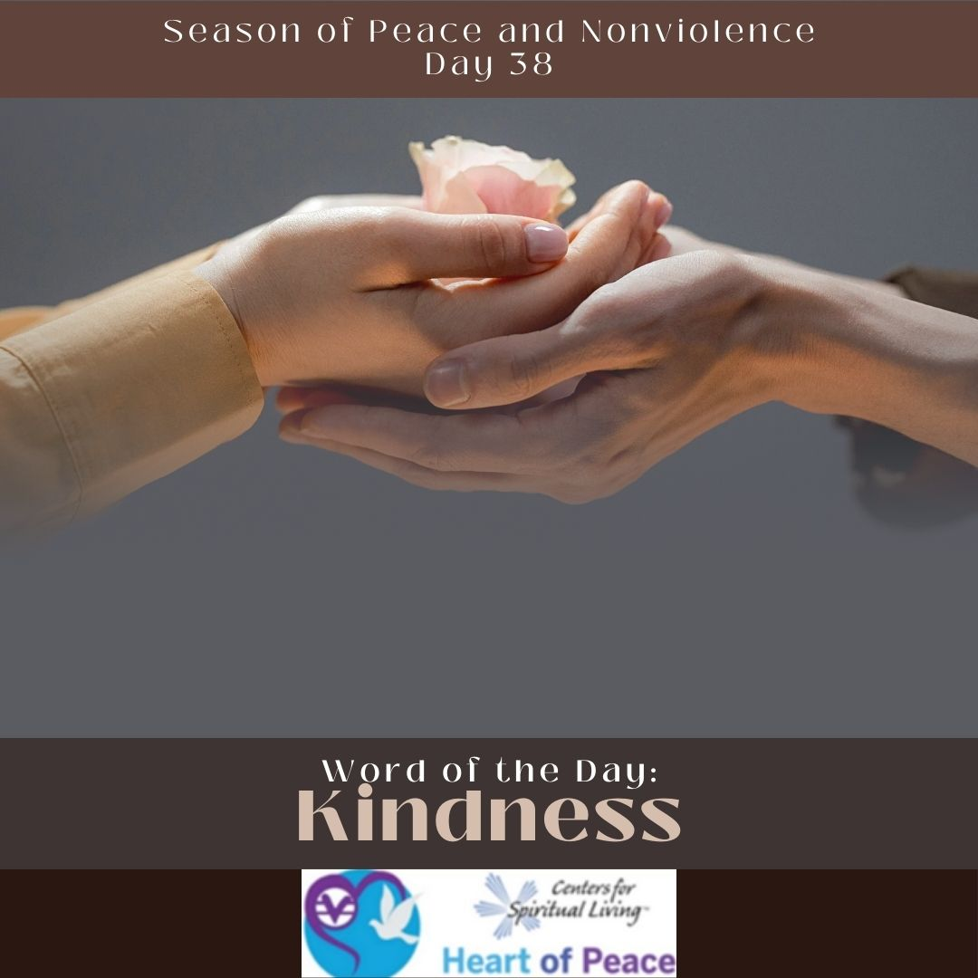
Day 38: Kindness
What is kindness?
When is it most difficult to be kind?
What do you do when someone is not kind to you?
How can you be kind to someone who is unkind or hurting?

Slide 5

Day 39: Dialogue
Why is dialogue important?
What steps can you take to improve your dialogue skills?
What gets in the way of clear dialogue?
How do you prepare for a difficult dialogue?
Who in your life could benefit from a better focus on dialogue? What steps will you take to improve this dialogue?

Slide 6
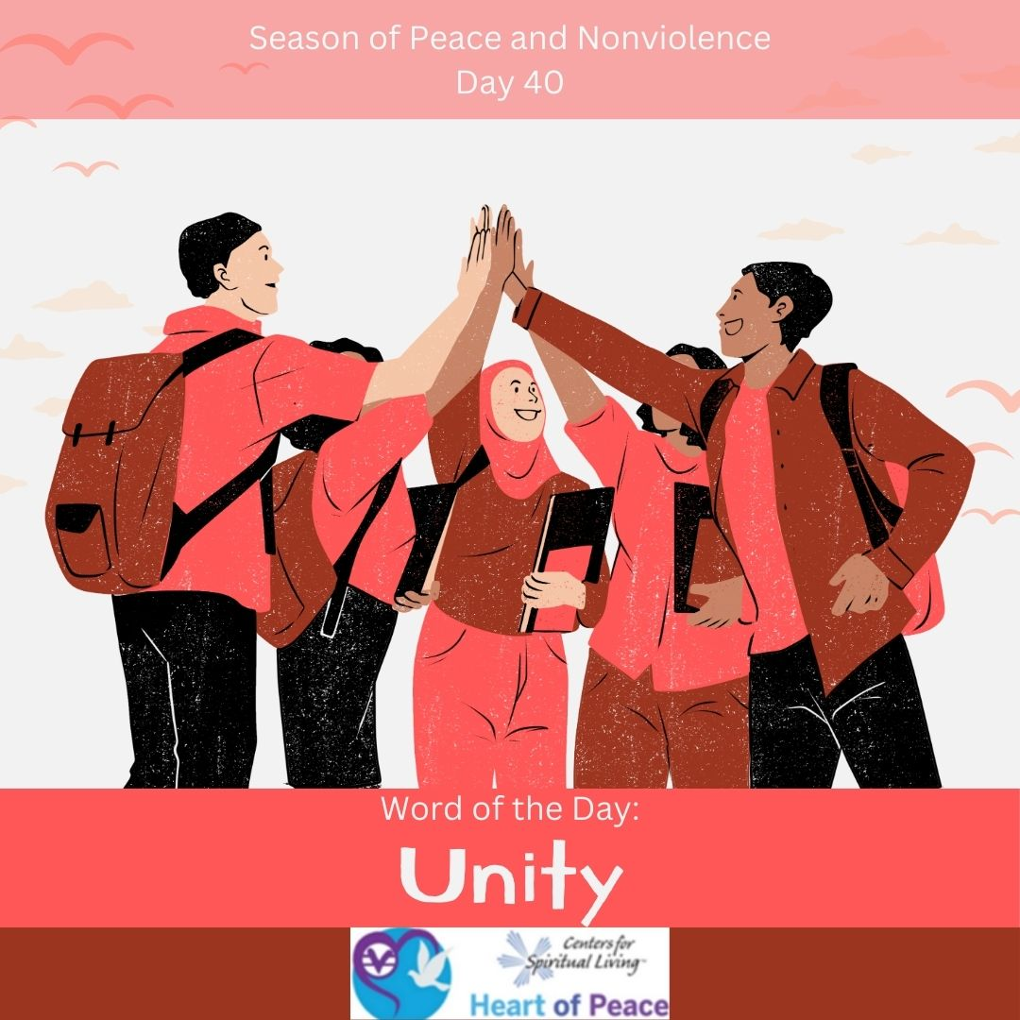
Day 40: Unity
Why is unity important?
How do you feel unity?
How do you develop unity in groups that seem to focus only on the differences?
Where in your life could benefit most from unity?

Slide 7
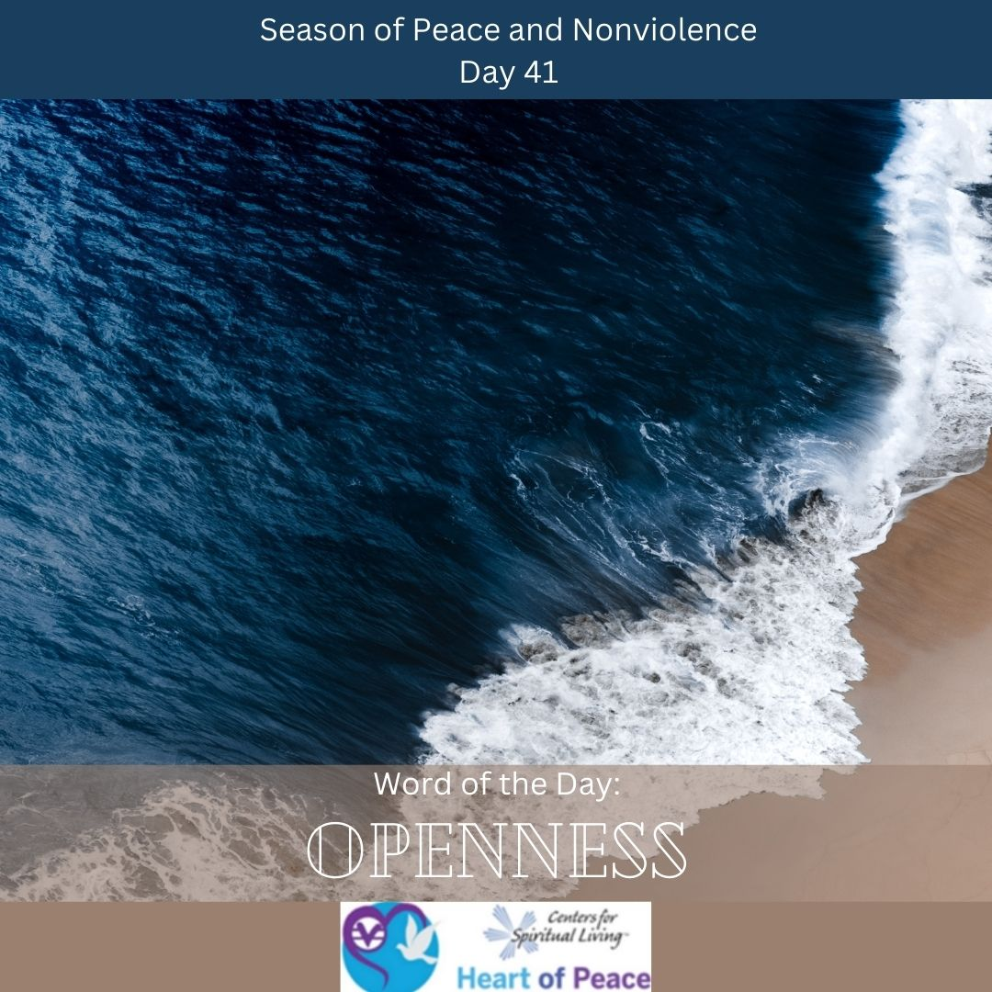
Day 41: Openness
What does it mean to be open?
Where in your life do you struggle with being open-minded?
How do you handle situations with people who don’t want to be open?
How do you create a space to allow for openness?

Slide 8

Day 42: Accountability
Why is accountability important?
How do you hold someone accountable? How can they return the favor?
How do you hold yourself accountable?
Where in your life do you most need accountability?

Slide 9
Summary Questions
How do this week's words apply to peace and nonviolence?
What challenges do this week’s words bring up for you?
What words do you feel you need to spend more time with?
What would help you most in incorporating these words in your life?

Slide 10
Week 6 Words- Added Resources
Day 36 – MINDFULNESS (March 6) - Mindfulness is thinking about what you're doing and knowing why you're doing it. As you walk through the day, be mindful of the way you treat others and the way you treat yourself. Today really pay attention.
Day 37 – GRACIOUSNESS (March 7)- Today, become aware of how you can sometimes be selfish in your life. Be really honest with yourself. Now focus on ways you can change that and be a more gracious person. What changes do you want to make?
Day 38 – KINDNESS (March 8)- Today, do a random act of kindness. Do something kind for someone for no reason other than to be kind. Notice how it makes you feel. Imagine if everyone did this all the time.
Day 39 – DIALOGUE (March 9)- We might not always agree with other people, but when we truly listen to what they have to say, we are having a dialogue. We never argue in a dialogue. We say what we think, and then we listen to the other person so we can understand what they think and learn from them. Choose a partner and talk about something with them that you usually disagree about. Have a dialogue instead of a disagreement or argument.
Day 40 – UNITY (March 10)- The world is made up of so many different people...different races, religions, sexual orientations, body types. We are all so different. Yet something unites us all as one. Today, focus on our unity. What makes us all the same, despite how different we might seem?
Day 41 – OPENNESS (March 11)- There is a Turkish proverb which says, "He who builds himself a fence, fences out more than he fences in." Try not to build fences round yourself to keep people out. Being open minded helps you learn things about people that you never would have. You don't have to agree with someone's life, but you learn more if you don't shut people out.
Day 42 – ACCOUNTABILITY (March 12)- Be accountable for your words and actions today. Make a note of where you are in your life. Are you being violent? Be willing to take responsibility for changing those behaviors today.
Document Source: Microsoft Word - 64-Daily_Practices-TEENS.doc

