Slide 1

Global Heart of Peace Sponsored
Season of Peace and Nonviolence
Week 7

Slide 2
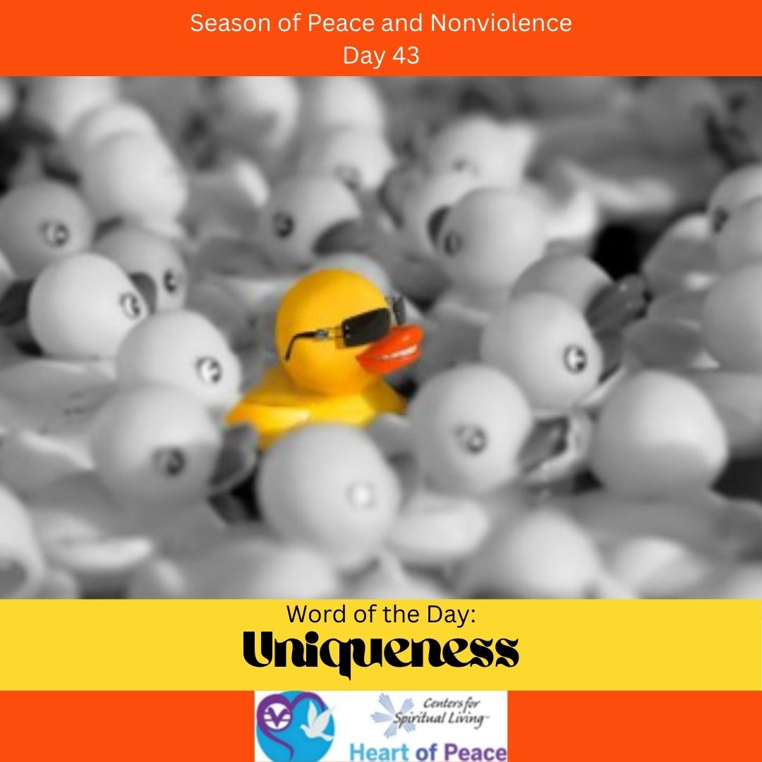
Day 43: Uniqueness
What makes you unique?
How do you handle other people’s uniqueness?
Why is uniqueness important if we are all One?
How do we balance our uniqueness with being part of the whole?

Slide 3
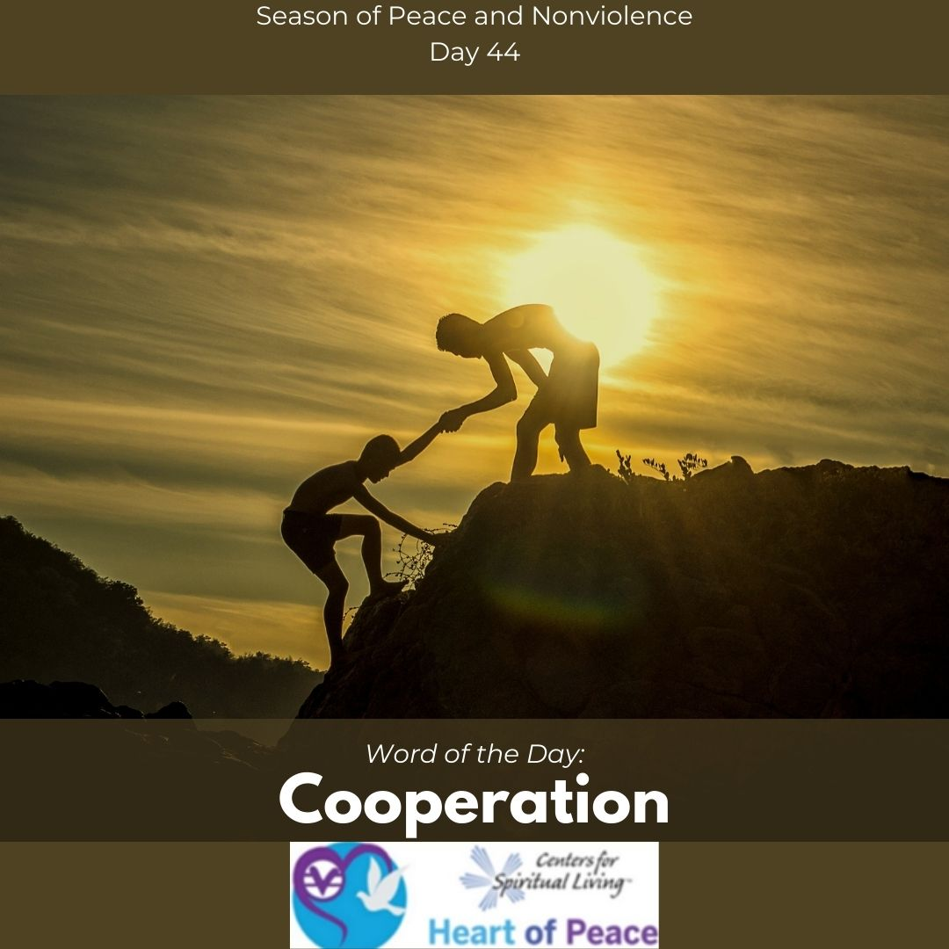
Day 44: Cooperation
Why is it important to cooperate?
What gets in the way the most with cooperation?
How do you start cooperating in difficult situations or when one person refuses to cooperate?
How do you cooperate without compromising what is most important?

Slide 4
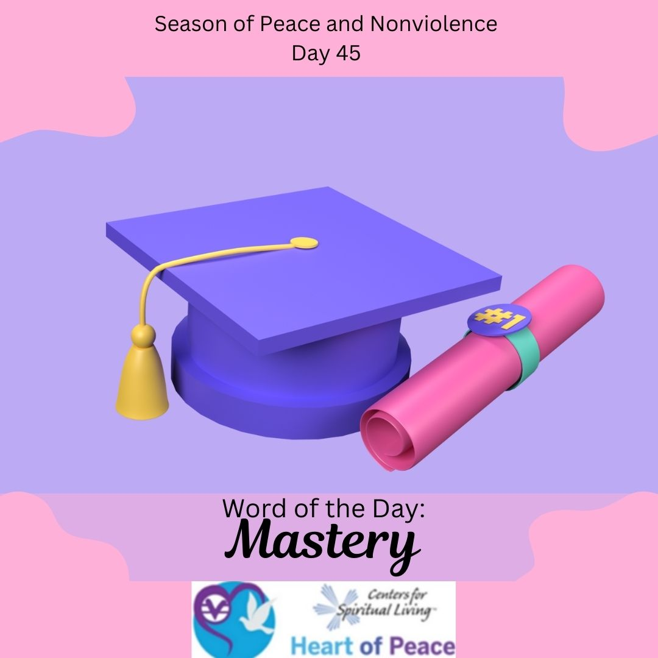
Day 45: Mastery
What does it mean to attain mastery?
Where in your life have you achieved mastery?
What would you like to master next?
How can mastering something important to you improve the world?

Slide 5
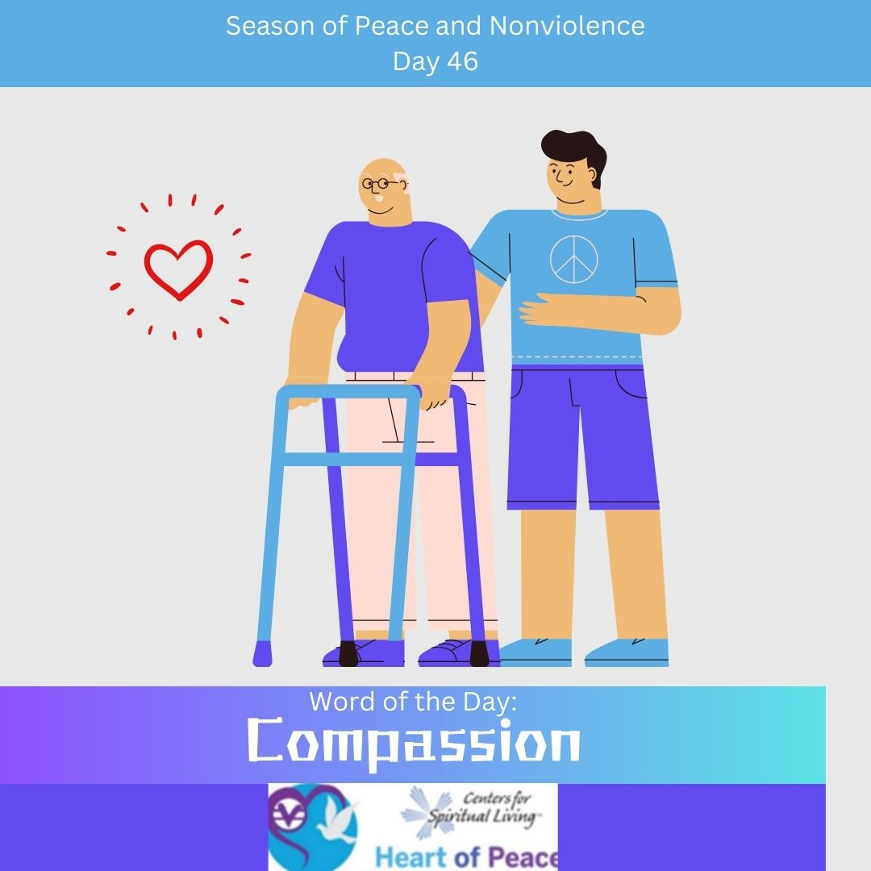
Day 46: Compassion
Where is it most important to show compassion?
Who is hardest for you to show compassion to?
How do you show compassion to someone who is at odds with you?
How can you be better about having compassion for yourself?

Slide 6

Day 47: Disarmament
Why is disarmament important?
What can you do as an individual to help with disarmament?
Does disarmament infringe on your rights?
Do we have the right to control who is armed and when? If so, what controls should exist?
Who should be in charge of who is armed?

Slide 7
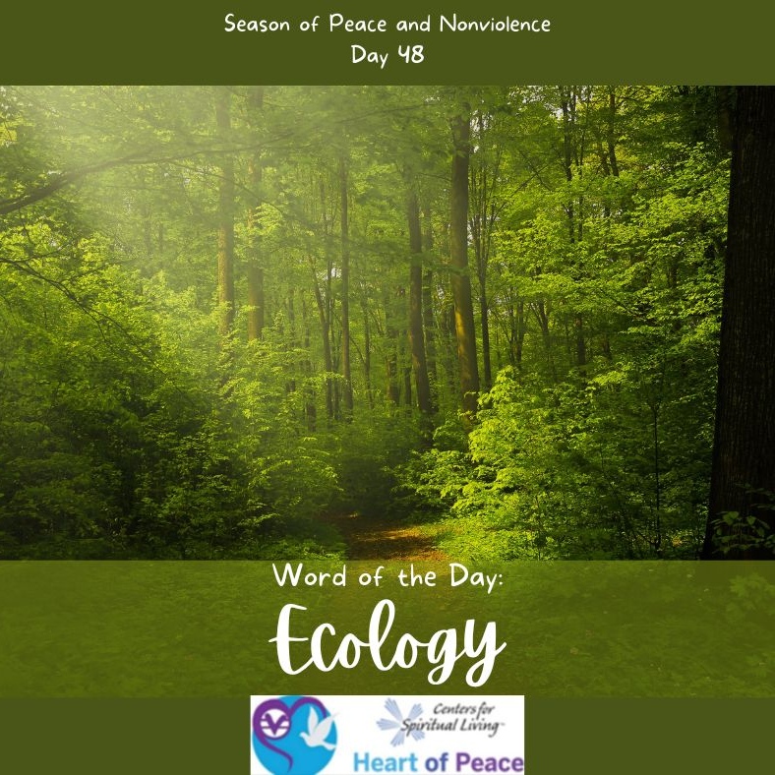
Day 48: Ecology
Why is ecology important?
What can you do to help the ecology?
Where can you make the most difference with the ecology?
How do you want to see the ecology evolve?

Slide 8
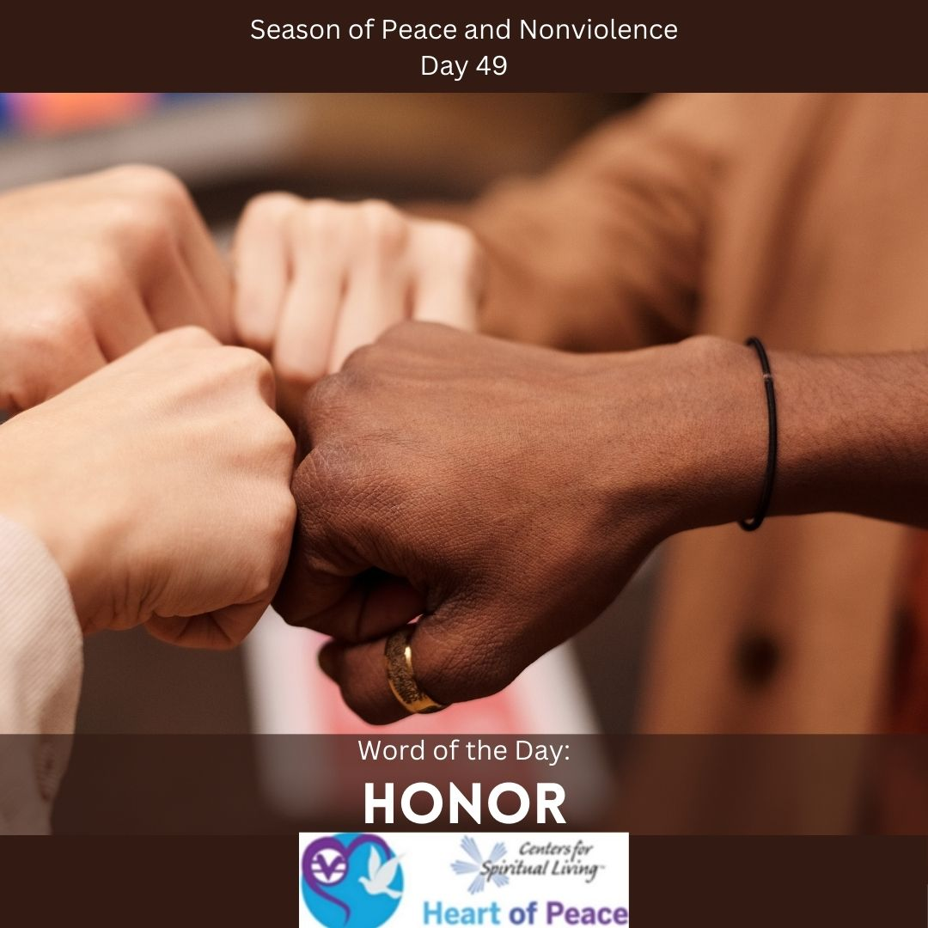
Day 49: Honor
What does honor mean to you?
How do you honor everyone and their differences?
How do you feel the most honored?
How does honoring each other affect relationships?

Slide 9
Summary Questions
How do this week's words apply to peace and nonviolence?
What challenges do this week’s words bring up for you?
What words do you feel you need to spend more time with?
What would help you most in incorporating these words in your life?

Slide 10
Week 7 Words- Added Resources
Day 43 – UNIQUENESS (March 13)- How are you unique? What makes you different from your family? Your friends? Today, focus on your own beautiful uniqueness. Don't judge yourself for your differences. Celebrate them.
Day 44 – COOPERATION (March 14)- When we work together, we are stronger than when we work alone. What are some things you can do with others around you to make the world more peaceful?
Day 45—MASTERY (March 15)- To practice nonviolence, you must learn to master your anger. If you find yourself angry, use positive thoughts and count backwards, from 10 through one, to calm yourself. If you do this when you become angry, you will achieve mastery over your emotions.
Day 46 – COMPASSION (March 16)- Mother Theresa said, "Find someone who thinks he is alone, and let him know that he is not." Today, offer your support to someone who needs it. Remember that everyone you meet goes through difficult things in their life. We all need love and support. Be that compassionate person today, and when you need compassion, people will be there to support you too. We must give compassion and love in order to receive it.
Day 47 – DISARMAMENT (March 17)- “…Nothing to kill or die for…Imagine all the people living life in peace…”- John Lennon. Talk to a random person today about what life would be like without weapons or war.
Day 48 – ECOLOGY (March 18)- Today, value the earth by recycling and using recycled products. Don't just think for today. Think about what your world will be like for your grandchildren's grandchildren and beyond that. It is our responsibility to heal this planet. We all deserve to have clean air, clean water, and a healthy food supply. Today, make a vow to stop contributing to the destruction of the planet. Do all you can and encourage others as well. If we want the world to change for the better, we must change it
Day 49 – HONOR (March 19)- Honor the people in your life who have loved and supported you through your hardest times, and those who will come to follow.
Document Source: Microsoft Word - 64-Daily_Practices-TEENS.doc

