Slide 1

Global Heart of Peace Sponsored
Season of Peace and Nonviolence
Week 8

Slide 2

Day 50: Choice
Why is it important that we are always at choice?
Why is it sometimes we feel like we have no choice? What is the best thing to do when this happens?
What happens when we choose not to choose?
What happens if we choose “wrong”?

Slide 3

Day 51: Advocacy
What does it mean to be an advocate?
How can you tell when someone needs an advocate?
How do you ask for advocacy when you need it?
What steps can you take to become a better advocate?

Slide 4

Day 52: Equality
What does equality mean?
How do we achieve equality and honor each other’s unique cultures and identities?
How do we achieve equality without someone feeling like they have to give up something?
Can equality ever be achieved on a global scale? If so, how?

Slide 5

Day 53: Action
How do you know what is yours to do?
How do you know when it is time to take action?
How do we take meaningful actions while remaining safe?
Is there such a thing as doing too much?

Slide 6
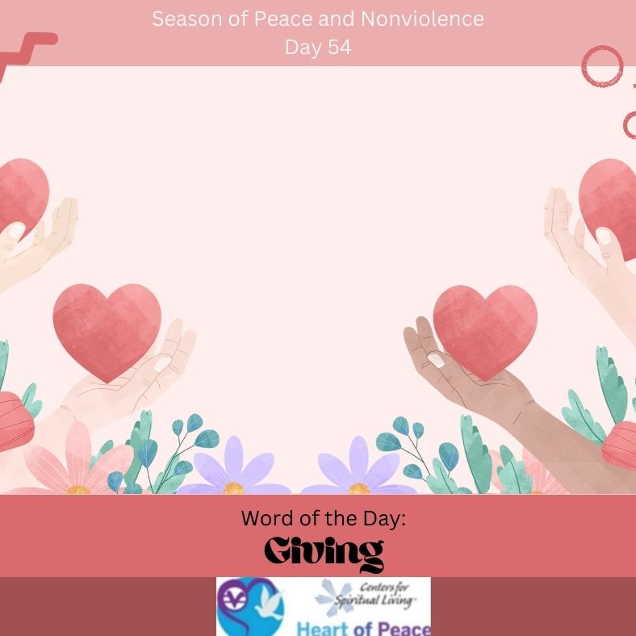
Day 54: Giving
What is the best way to be giving?
What is most important to you about giving?
Where are you the most giving? The least giving?
What steps can you commit to taking to become more giving?

Slide 7
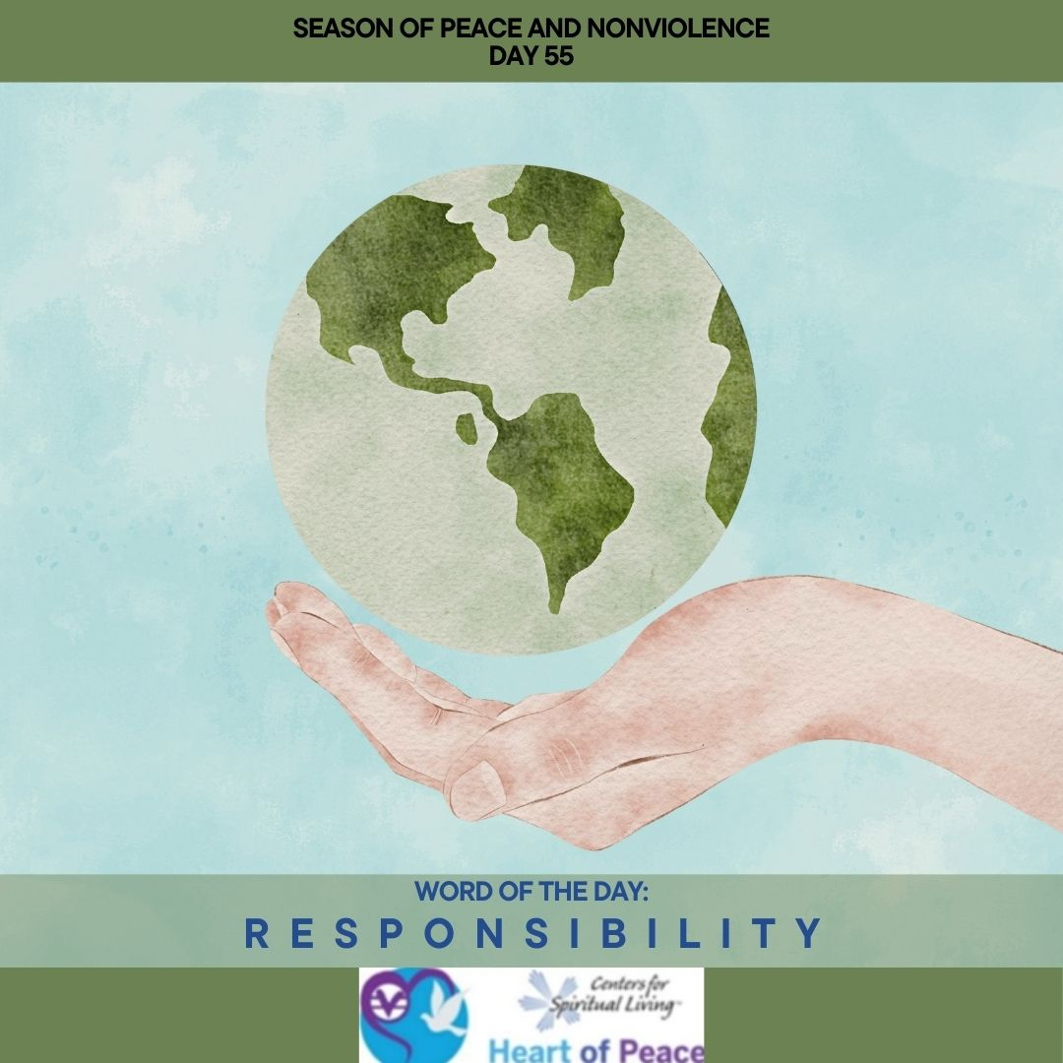
Day 55: Responsibility
What is the importance of responsibility?
Who has the right to hold whom responsible?
What is your responsibility in changing the world?
How do you handle responsibility?

Slide 8
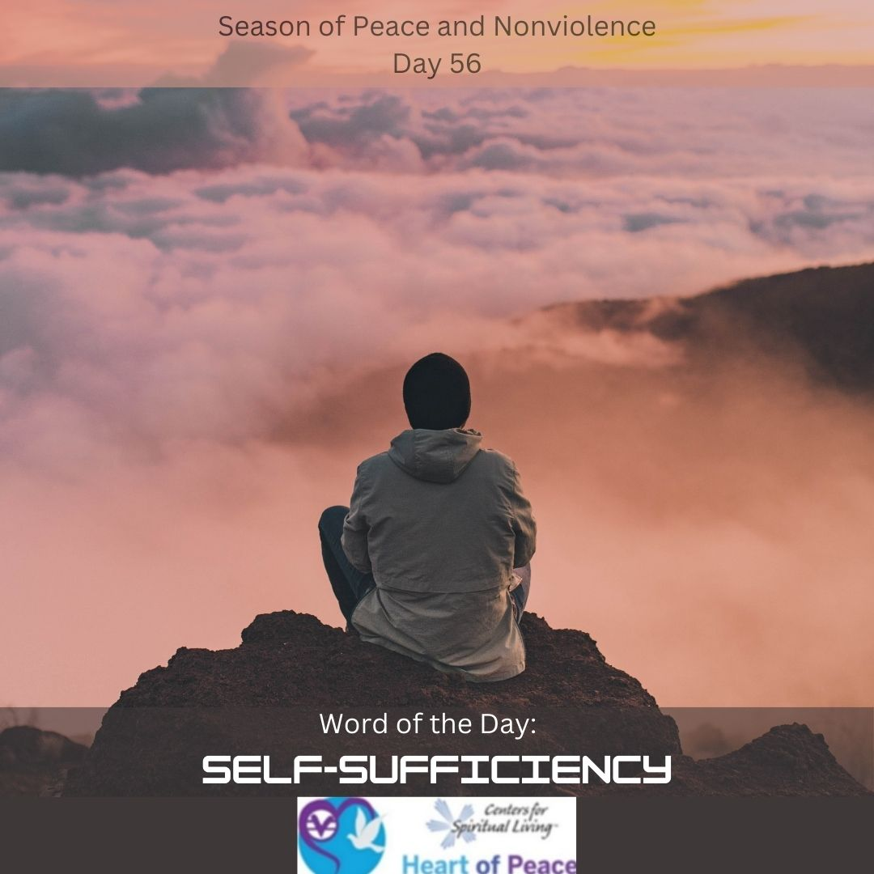
Day 56: Self-Sufficiency
What does it mean to be self-sufficient?
When does self-sufficiency become a problem? Can you be too self-sufficient?
How does self-sufficiency affect interpersonal relationships?
Are there places in your life where you would benefit from being more self-sufficient?

Slide 9
Summary Questions
How do this week's words apply to peace and nonviolence?
What challenges do this week’s words bring up for you?
What words do you feel you need to spend more time with?
What would help you most in incorporating these words in your life?

Slide 10
Week 8 Words- Added Resources
Day 50 – CHOICE (March 20) - You have the option to choose a path of violence or nonviolence. We are always at choice in our lives. Today, choose nonviolence.
Day 51 – ADVOCACY (March 21)- “Every action for peace requires someone to exhibit the courage to challenge violence and inspire love,” said Buddhist teacher, Thich Nhat Hanh. How can you advocate for a better world today?
Day 52 – EQUALITY (March 22)- “Unity among every living thing.” Today, try to view everyone through loving, non-judgmental eyes. See them as though they are your own brothers and sisters.
Day 53 – ACTION (March 23)- “Be the change you wish to see in the world,” said Gandhi. Today, you have the choice between positive and negative action. Choose the most positive actions for the universe.
Day 54 – GIVING (March 24)- Giving and receiving go hand in hand. The more you give, the more you receive. Practice giving with no thought of return. Notice how people who never give to others, never receive from others. When you shut down your ability to give, you also shut down your ability to receive. Practice this and notice how your life changes for the better. Give of your time, your energy, your material possessions, or just give love and support.
Day 55 – RESPONSIBILITY (March 25)- Take responsibility for your actions today. The quality of our world depends on you. What can you do today to better the world or even just your own environment? Think of ways you can be more responsible for helping your community, family, or your friends.
Day 56 – SELF-SUFFICIENCY (March 26)- Think about what you want to do for a living. What do you want your life to look like? What do you want to have? How do you want to feel? What steps do you need to take to get to your goals? How can you become self-sufficient?
Document Source: Microsoft Word - 64-Daily_Practices-TEENS.doc

