Slide 1

Global Heart of Peace Sponsored
Season of Peace and Nonviolence
Week 9

Slide 2
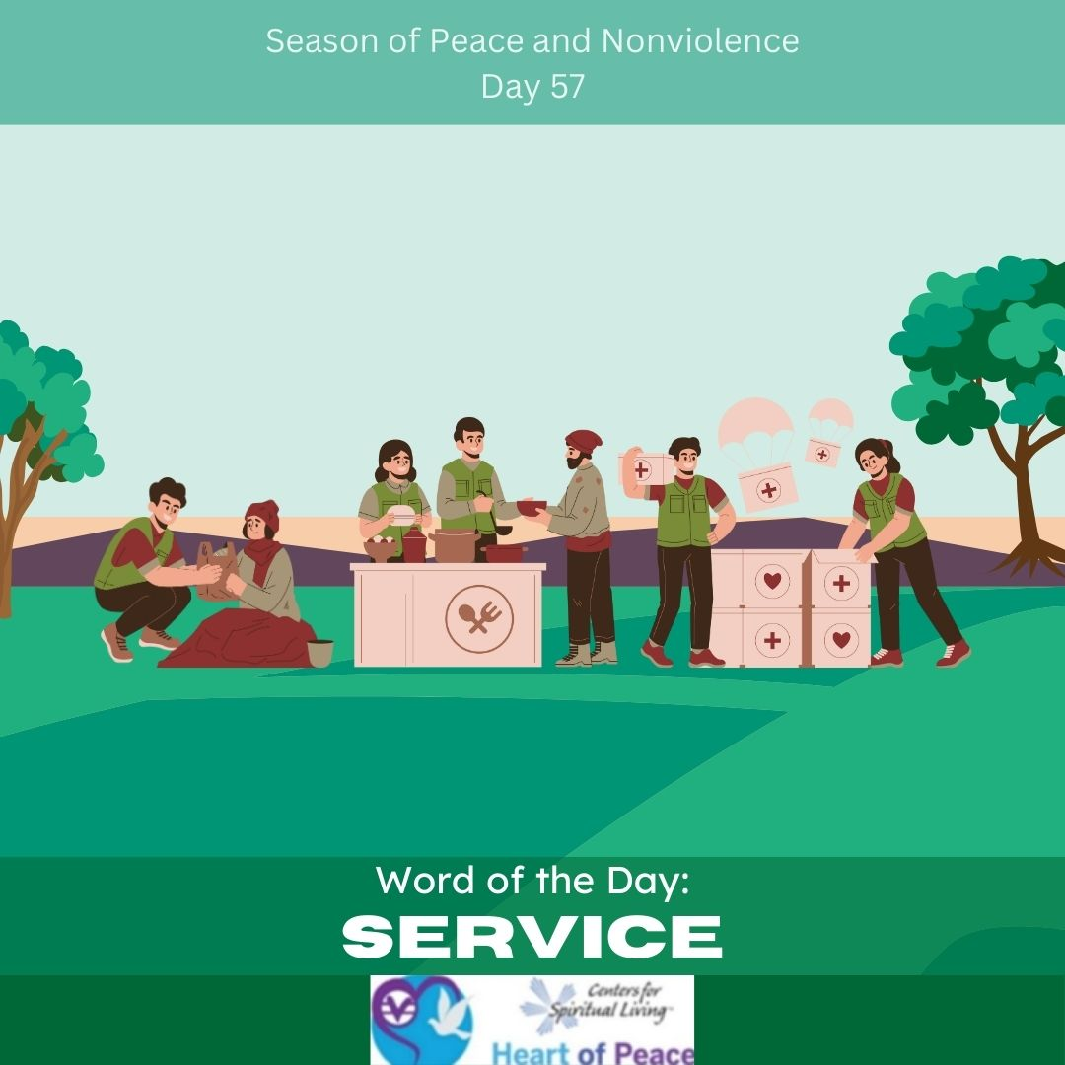
Day 57: Service
What does service mean to you?
In what ways are you in service to others?
In what ways do you want to be more of service?
Who can best benefit from your unique talents in service?

Slide 3
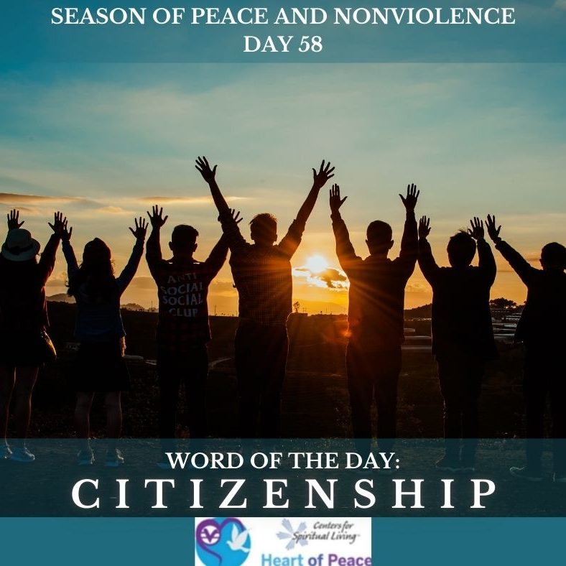
Day 58: Citizenship
In what groups do you consider yourself a citizen?
Is citizenship important to you? Why or why not?
What responsibilities come with citizenship?
How do you grow your citizenship?

Slide 4
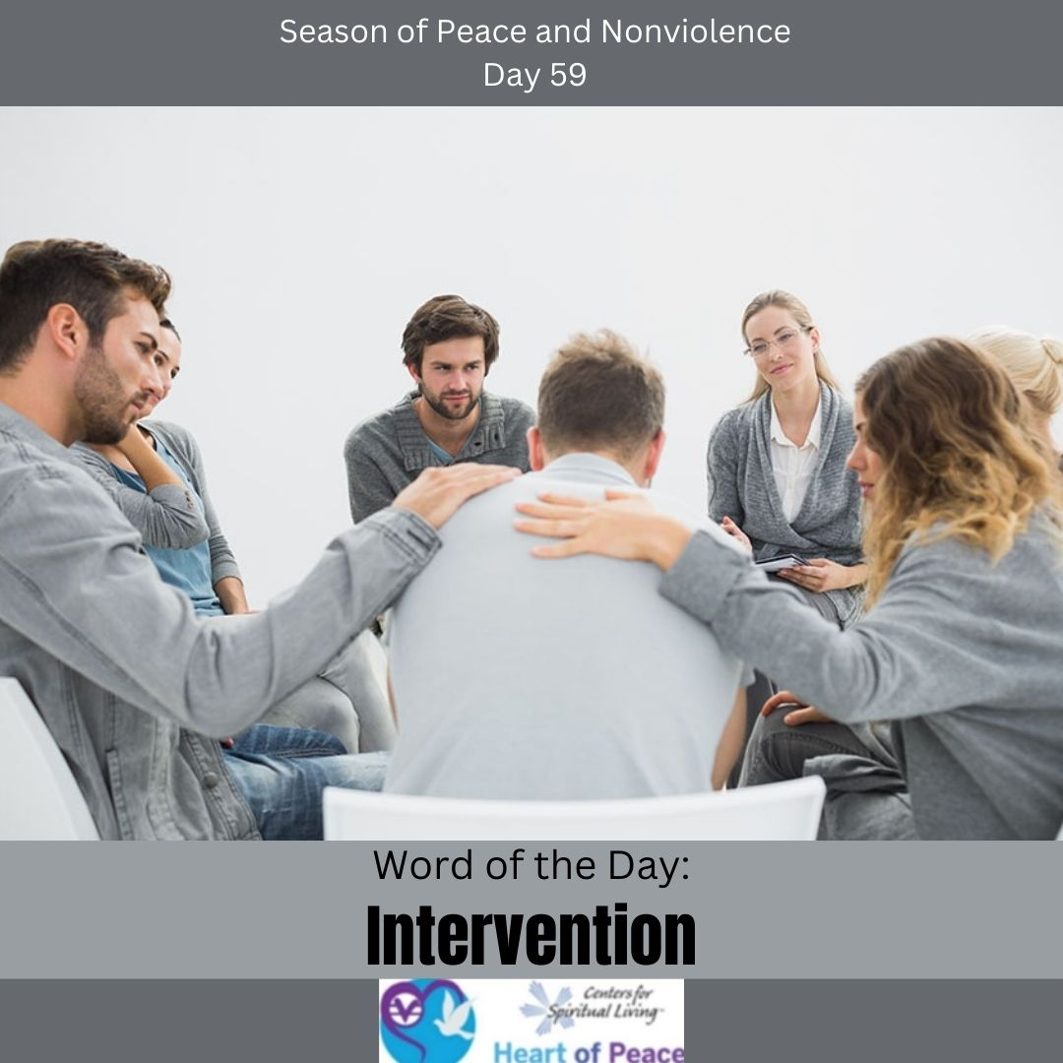
Day 59: Intervention
How do you know it is time for an intervention?
What benefits can an intervention have?
Who should initiate an intervention?
Is there any where in your life that you feel would benefit from an intervention?

Slide 5
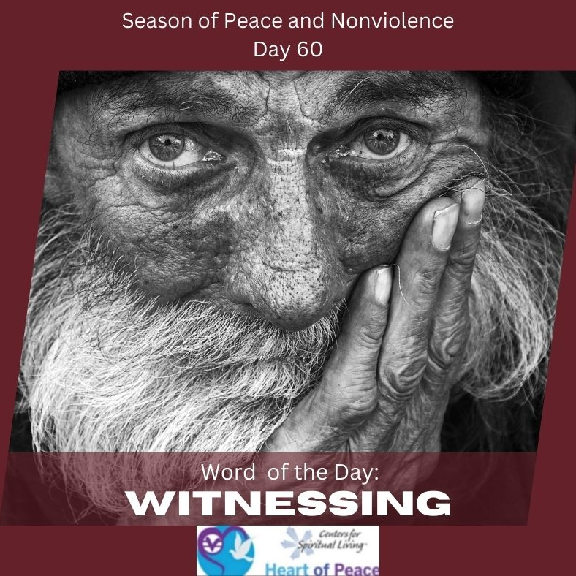
Day 60: Witnessing
What is important about witnessing versus just seeing?
What are you witnessing in your life that you would like to do something about?
Are there places you wished someone would witness you?
How can you develop skills in truly witnessing?

Slide 6
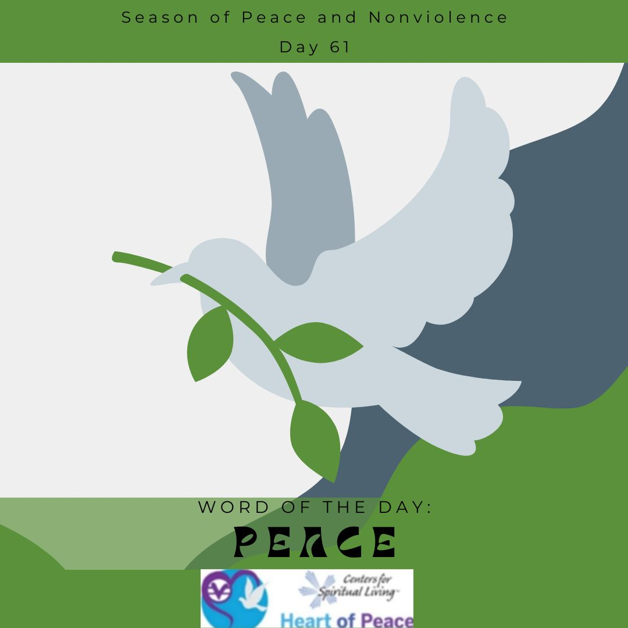
Day 61: Peace
What does peace feel like to you?
How do you know when you are at peace?
How do you exemplify peace?
Why is internal peace important?
How do we move from internal peace to global peace?

Slide 7
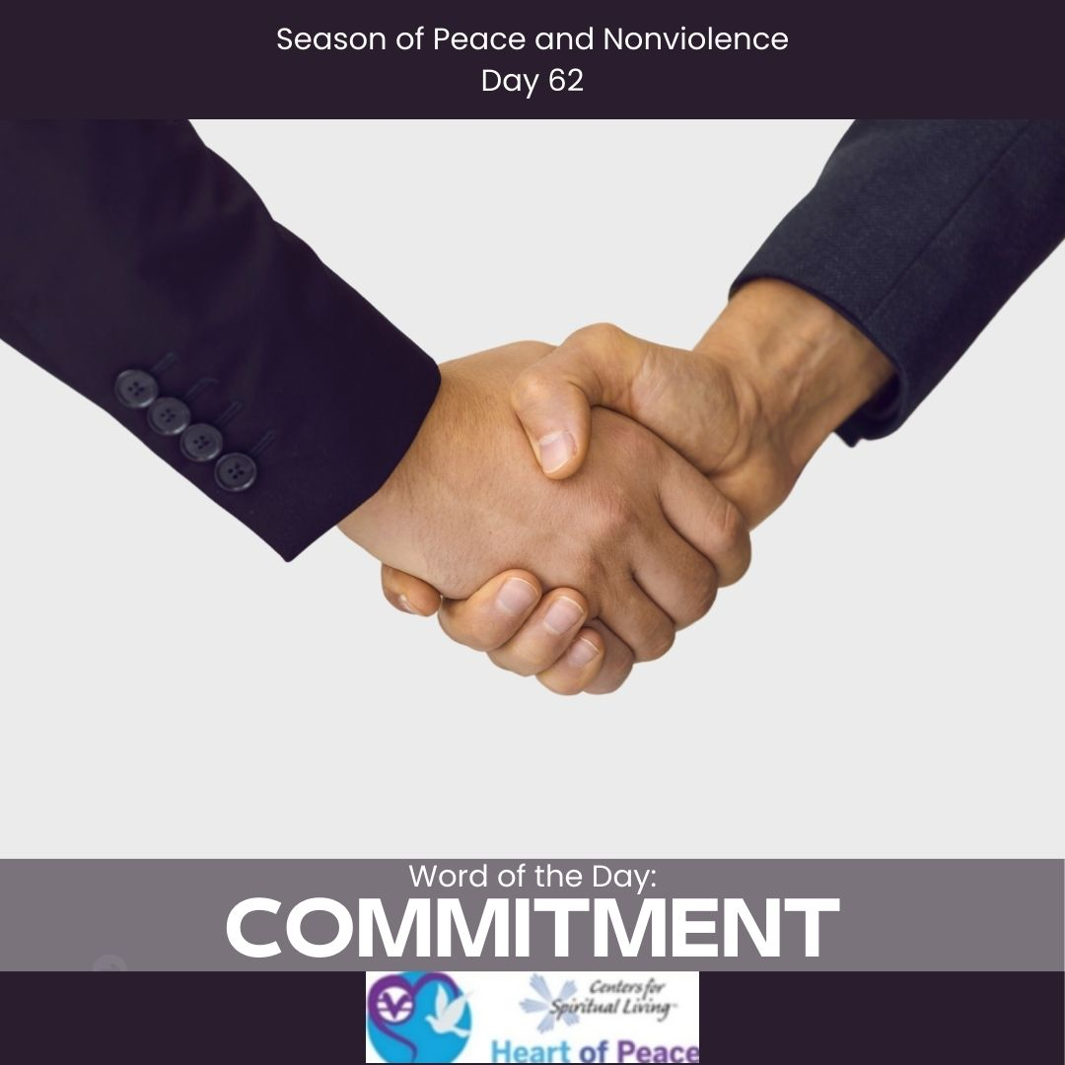
Day 62: Commitment
Why is commitment important?
Where do you struggle the most with commitment?
What is the most important thing for you to be committed to?
Who can benefit most from your commitment?

Slide 8
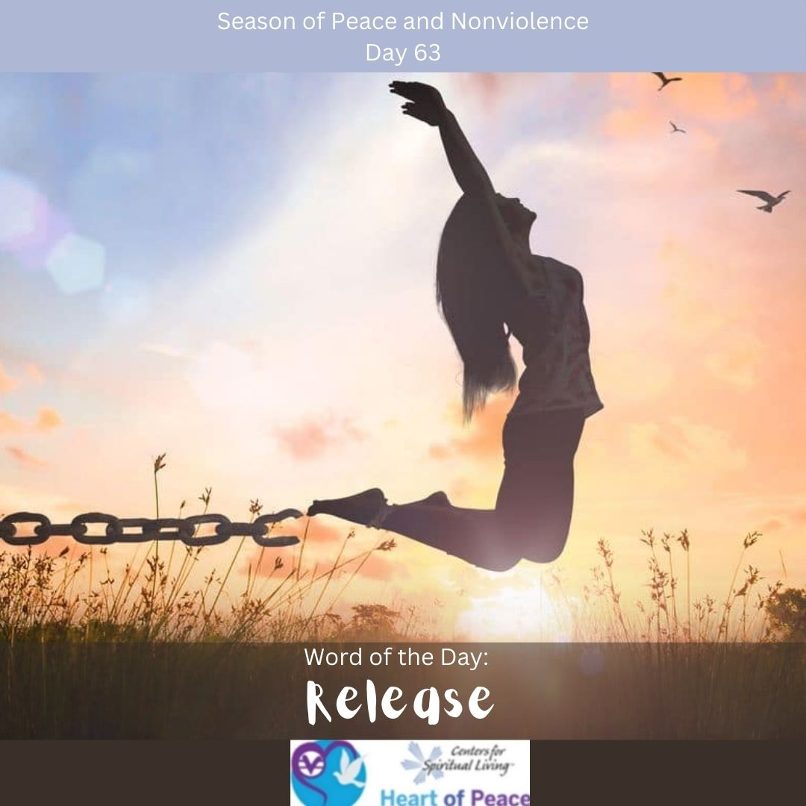
Day 63: Release
What do you most need to release to find peace?
What does it feel like to release something that has been holding you back?
How do you know what and when you need to release?
What is stopping you from releasing what needs to be released?

Slide 9
Summary Questions
How do this week's words apply to peace and nonviolence?
What challenges do this week’s words bring up for you?
What words do you feel you need to spend more time with?
What would help you most in incorporating these words in your life?

Slide 10
Week 9 Words- Added Resources
Day 57 – SERVICE (March 27) - Dr. Martin Luther King, Jr. said," Everybody can be great, because any body can serve. You only need a heart full of grace and a soul generated by love." Choose one thing you can do to help serve the world. How would you enjoy serving? Make a commitment today to give back to the world in your own unique way. Every little thing makes a difference. Serving others makes you feel good about yourself.
Day 58 – CITIZENSHIP (March 28)- How can you be a better citizen of your community? You belong to many communities...your family, school, church, and your town. How can you improve your community today? Think about ways you can bring more peace to your environment.
Day 59 – INTERVENTION (March 29)- Alcohol and drug abuse cause violence and are a consequence of violence. We all know someone whose life is affected by some sort of addiction. What can you do to help one of these people in your life? Encourage them to love themselves enough to reach out for help. Support them through this difficult time, and help them find the help they need.
Day 60 – WITNESSING (March 30)- Those who practice nonviolence look at injustice and think, "It is possible for this situation to be different." When you see injustice, what can you do to bring about a peaceful change? How can you stand up for peace in your life?
Day 61 – PEACE (March 31)- Thich Nhat Hanh wrote," Practice watering seeds of joy and peace and not just seeds of anger and violence, and the elements of war in all of us will be transformed." If you focus on peace, joy, and love in your life, you will experience more of that. But if your mind is filled with negativity, it is hard to experience the good in life.
Day 62 – COMMITMENT (April 1)- Take a moment to think of your commitment to nonviolence. Are you willing to commit to a nonviolent lifestyle? What are you willing to change about yourself? Get with a partner and talk about this.
Day 63 – RELEASE (April 2)- Today, look back on how far we have come during this 64 daily practices of nonviolence. Make a list of what you need to release in order to be a nonviolent person. Is it your temper, your impatience, your judgmental attitude? Know that you always have a choice, and you can let go of things that do not serve you anymore. You can take your list and burn it, if you'd like. Release what is no longer serving you, and make new commitments to yourself to be more peaceful and loving. Know that you truly make a difference in the world.
Document Source: Microsoft Word - 64-Daily_Practices-TEENS.doc

